Slide 1

Skull Detectives

Slide 2
Today we are going to be skull detectives! We will observe skulls of three different native animals and make educated guesses about what they eat.
What part of the skull will help us find out what an animal eats?

Slide 3
The teeth!
The different types of teeth in our mouth help us eat different types of food.
There are scientific words to describe what an animal eats. Do you know any of them?

Slide 4
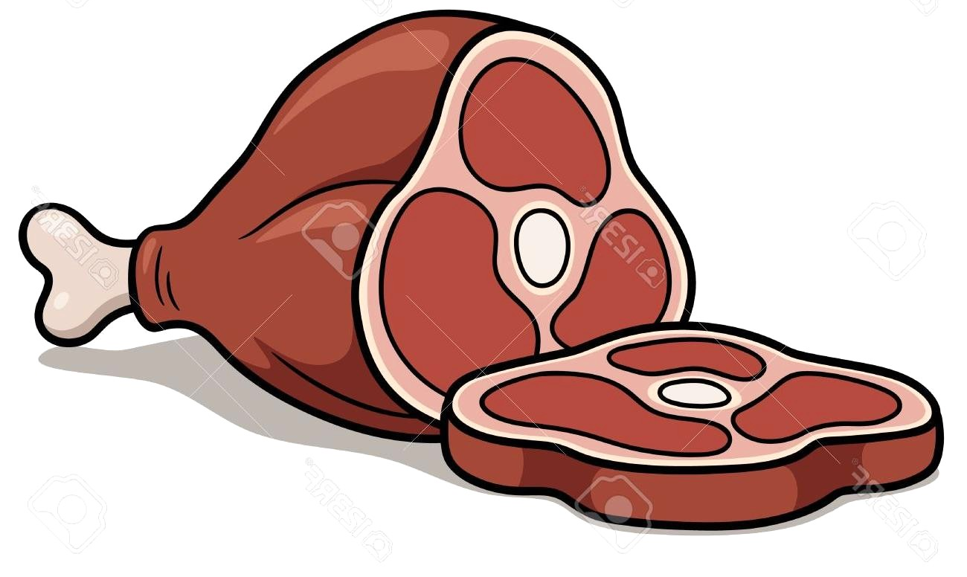

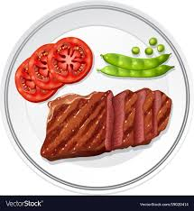
Click to see the answers:
What is the scientific word for an animal that eats only meat?
What is the scientific word for an animal that eats only plants?
What is the scientific word for an animal that can eat both plants and animals?
Carnivore
Herbivore
Omnivore
Humans are omnivores!

Slide 5


Now use your tongue to feel your front teeth. What do you notice about them?
Next use your tongue and feel your back teeth. Are they the same as the front teeth? What is different about them?
You can also look in a mirror to see your teeth
I notice that my back teeth are flat and bumpy and that my front teeth are pointy and smooth

Slide 6
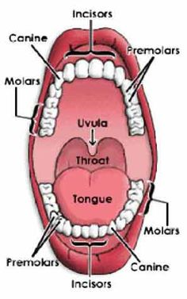
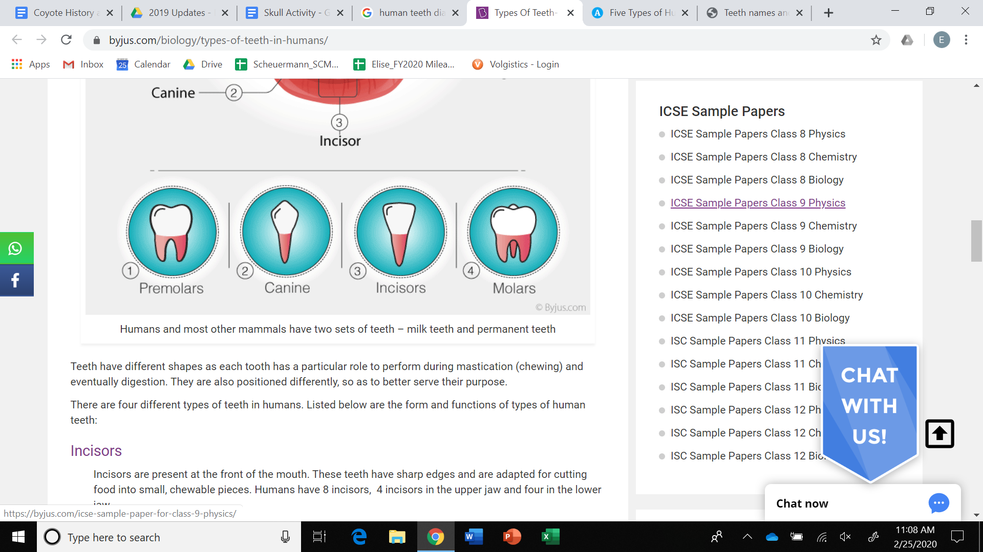
This is a diagram of the human mouth. Look at the diagram to find each tooth type and then find it in your own mouth!

Slide 7
Incisors help us bite off pieces of food.
Canines help us grip and tear food.
Carnivores have canines to tear meat.
Molars help us grind and chew up food. Herbivores will have molars for grinding up plants.

Slide 8

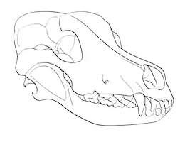
Be a Skull detective
On the next three slides look closely at the skulls and their teeth.
We can figure out what the animal might eat based off what type of teeth they have.
Are they are a carnivore, omnivore, or herbivore?
Choose one skull for each category and think of at least one reason why.
Write down your answers so that you can reference them later.

Slide 9
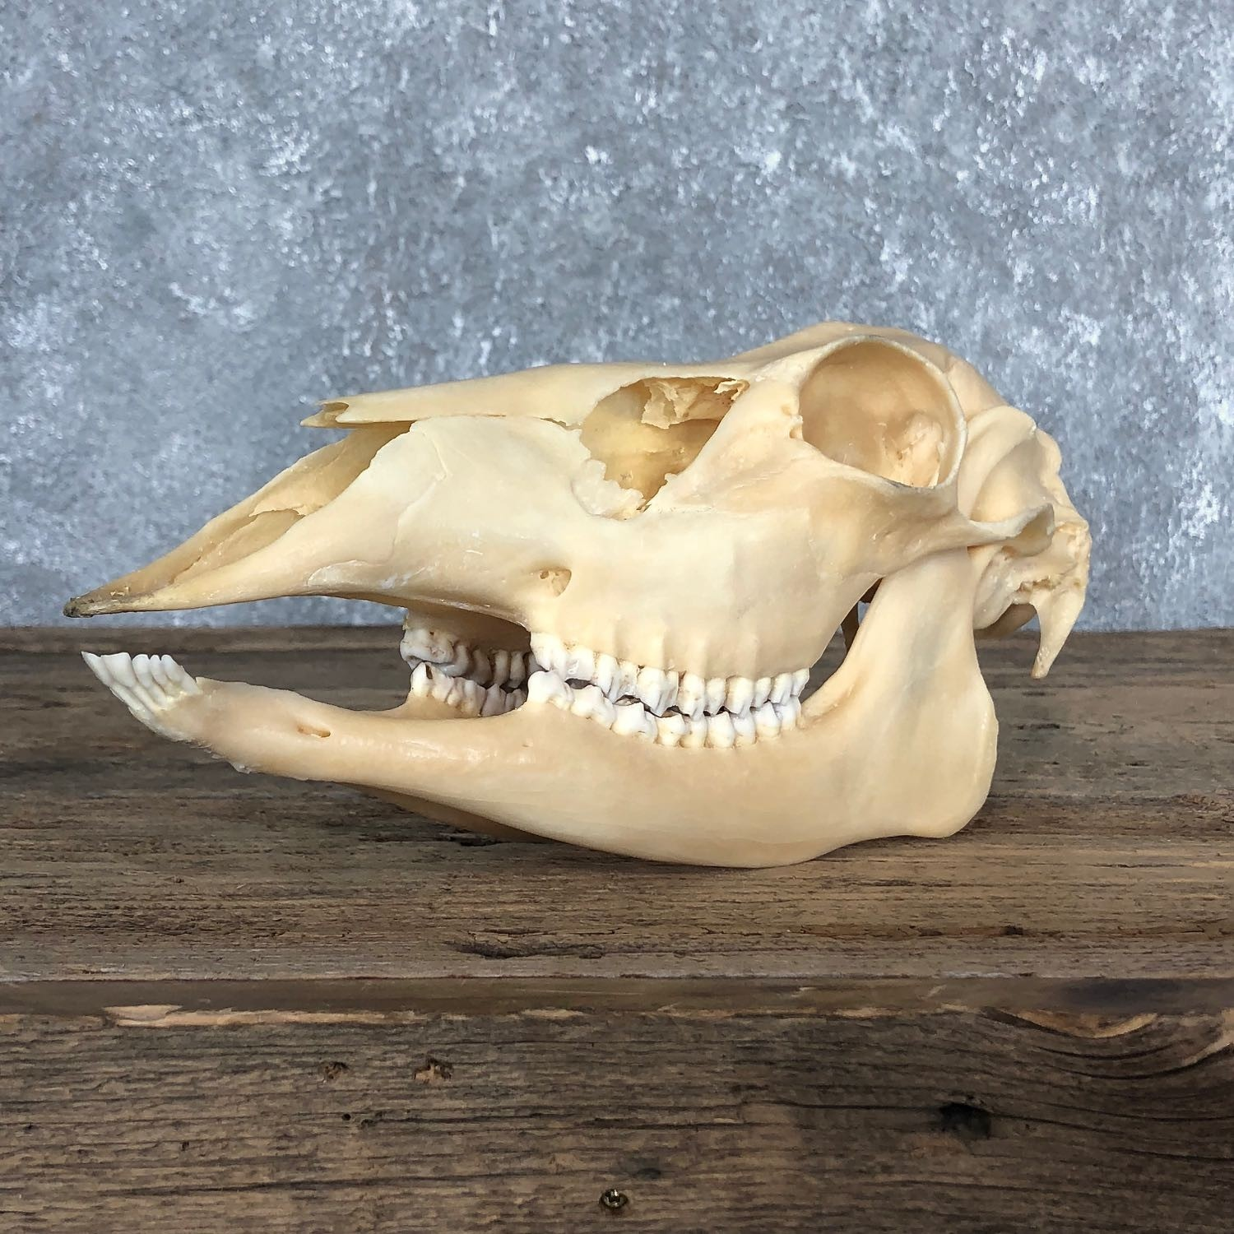
Mystery SKull #1

Slide 10
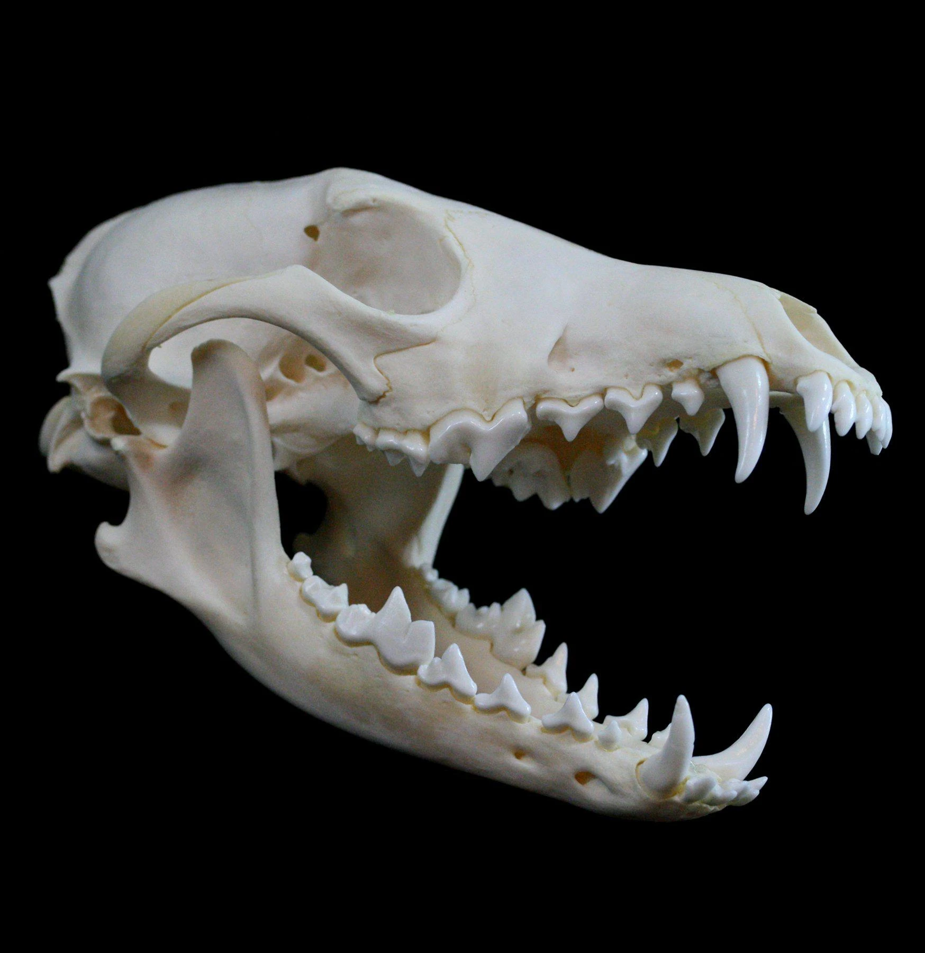
Mystery Skull #2

Slide 11
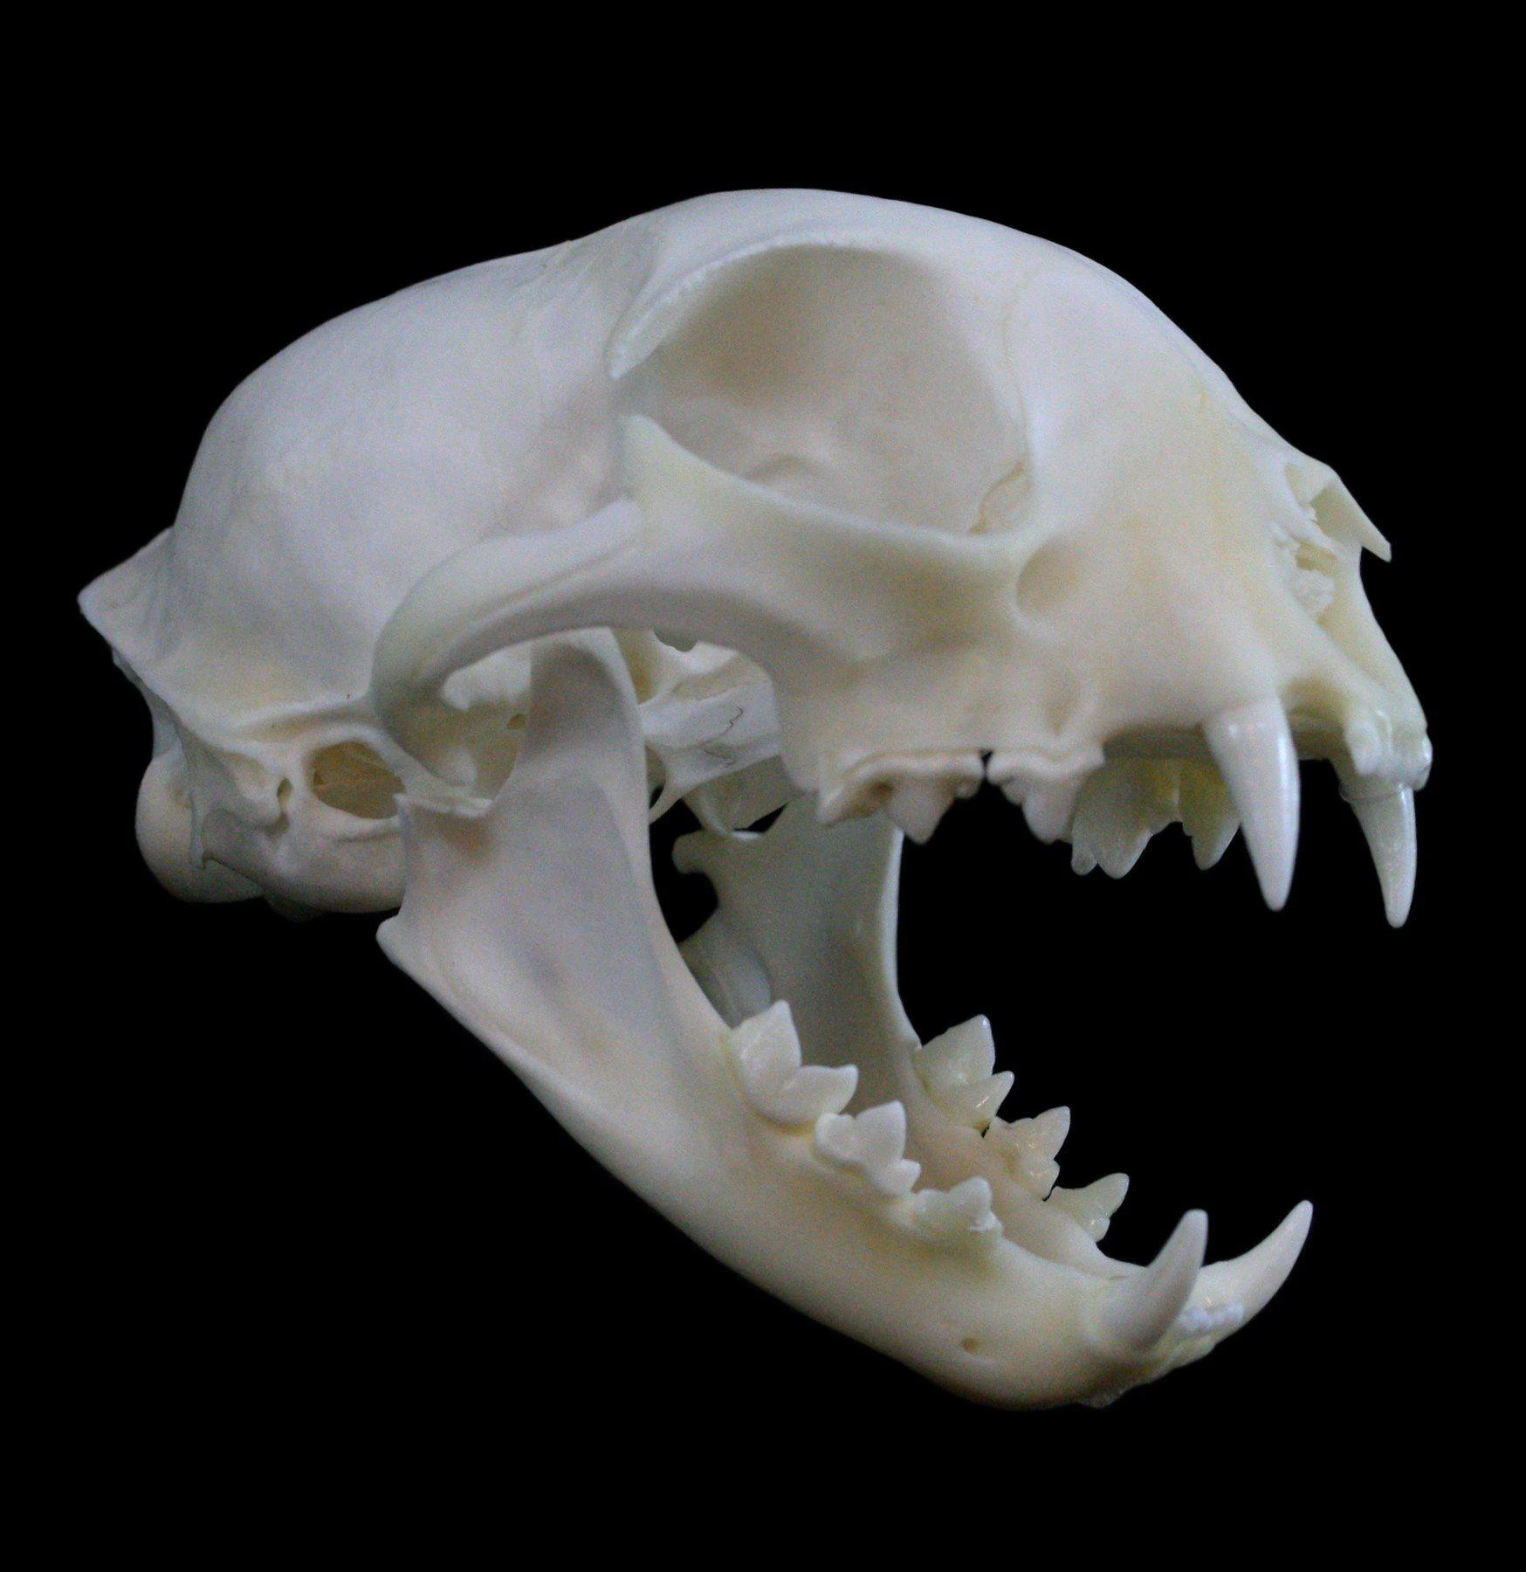
Mystery Skull #3

Slide 12
Who am I?
Do you think this animal is a carnivore, omnivore, or herbivore? Why?
Click to reveal hints
I have molars in my mouth, which are flat and bumpy
Perfect for grinding up plants!
No pointy canines for tearing
Mystery Skull #1
I am an herbivore!
Notes:
I have molars in my mouth, which are flat and bumpy, perfect for grinding up plants!

Slide 13
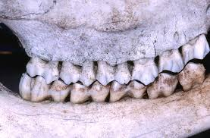
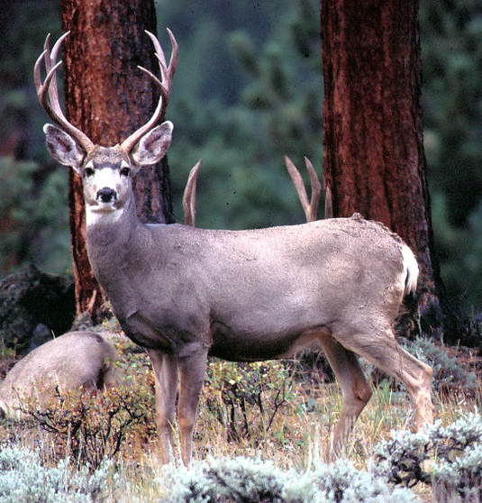
I am an herbivore and...
I live in Santa Cruz and can be found in meadows and forests.
Sometimes I have things called antlers growing out of my head!
I eat grass, berries, and seeds.
I am A Deer!

Slide 14
Who am I?
Do you think this animal is a carnivore, omnivore, or herbivore? Why?
Click to reveal hints
Just like you, I have the mouth of an omnivore!
I have sharp canines, pointy incisors, and bumpy molars.
That means it is easy for me to eat both plants and meat.
Mystery Skull #2
I am an Omnivore!

Slide 15
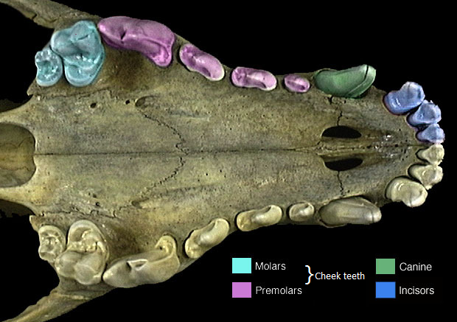
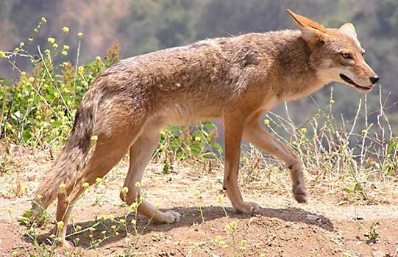
I am an omnivore and...
I am not a picky eater and will eat anything I find such as small animals, plants, and berries.
I am a relative of dogs.
I have good camouflage but you might have seen me before.
I am A Coyote!

Slide 16
Who am I?
Do you think this animal is a carnivore, omnivore, or herbivore? Why?
Click to reveal hints
I have super sharp teeth and large canines for catching prey.
My molars are sharp and pointy.
Mystery Skull #3
I am a Carnivore!

Slide 17
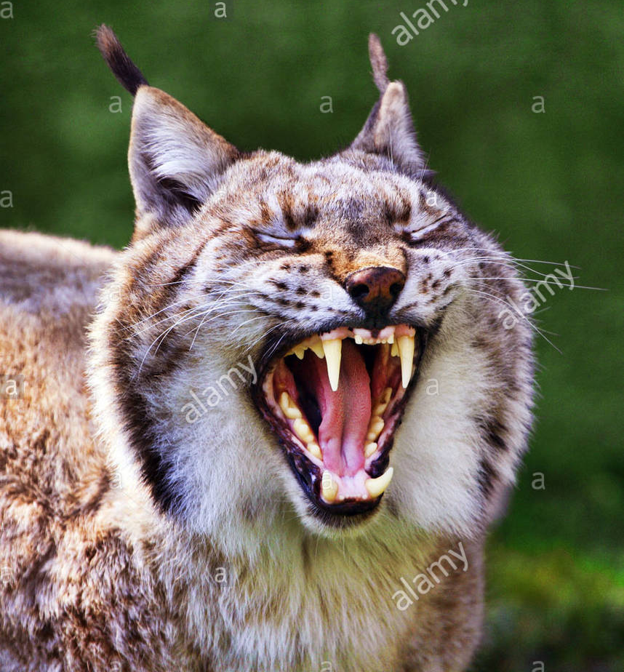
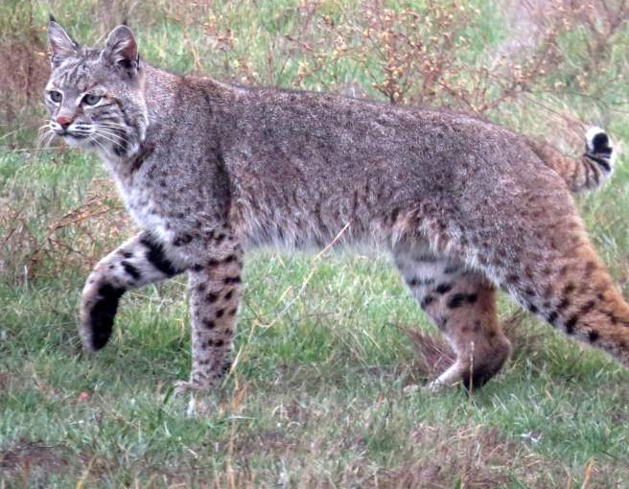
I am a carnivore and...
I live in Santa Cruz but you probably have not seen me because I come out during the night.
I am a predator and hunt other animals.
I am a relative of house cats!
I am A Bobcat!

Slide 18

Draw a skull!
Choose one of the animals we just learned about and draw their skull! The next 3 slides have the images for reference. You can also look up other images online to draw it from a different view.
Questions to think about while drawing
  What do you notice about the other features on the skull?
  Where are the eyes placed? On the side or on the front?
Say this outloud “eyes in front hunt, eyes on side hide”
Once you have drawn your skull, label the types of teeth using these terms: molar, canine, incisor

Slide 19
SKull #1 - Deer
What do you notice about the other features on the skull?
Where are the eyes placed? On the side or on the front?

Slide 20
Skull #2 - Coyote
What do you notice about the other features on the skull?
Where are the eyes placed? On the side or on the front?

Slide 21
Skull #3 - Bobcat
What do you notice about the other features on the skull?
Where are the eyes placed? On the side or on the front?

