Slide 1
BIRD BEAKS!

Slide 2
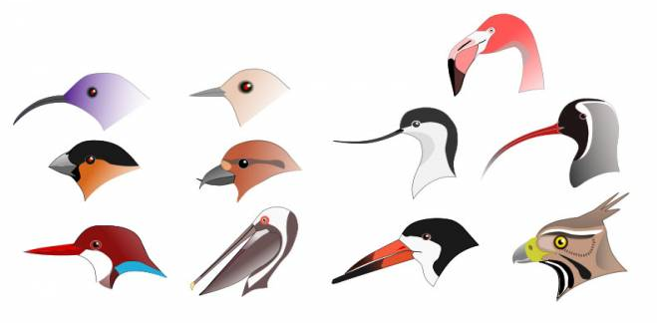
Today we are going to be thinking about how birds eat and how they are able to survive by getting food in the wild!

Slide 3
Did you know that birds don’t have teeth to chew their food like we do?! So how do you think they eat food?

Slide 4
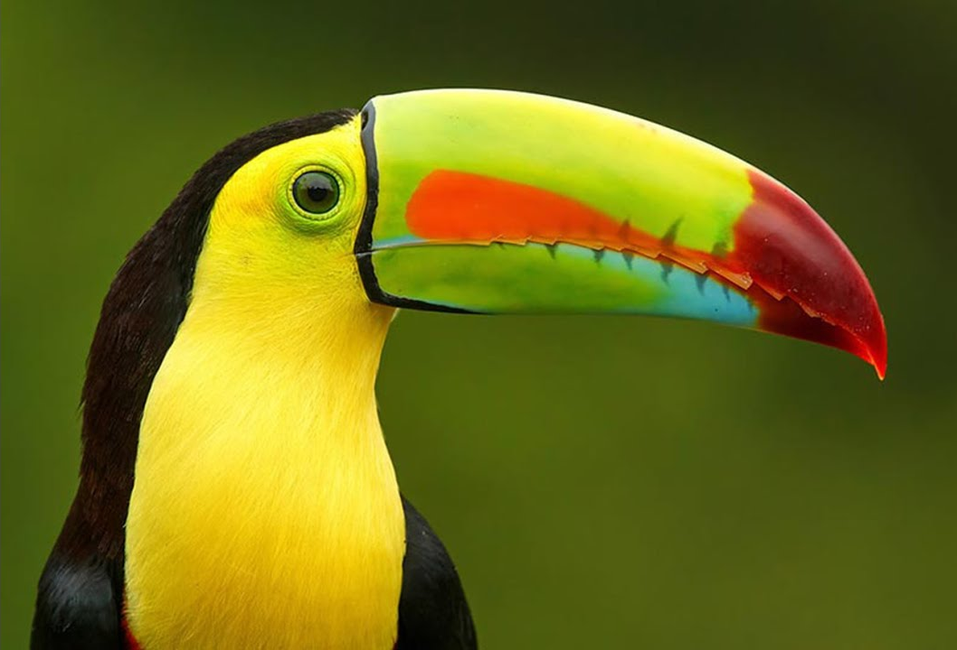
Birds have a special body part to help them eat.
Do you know what this part of a bird is called?
Yes! It is a BEAK.

Slide 5
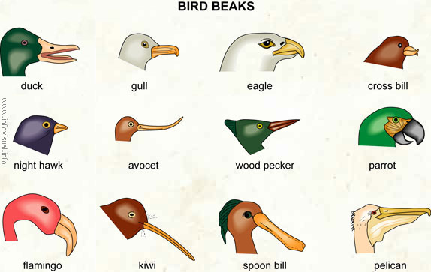
Look at the picture below. What do you notice about the beaks of these birds?
I notice that each bird has a beak, but they all look different from each other!
Bird’s beaks are shaped differently depending on the type of food they eat!

Slide 6
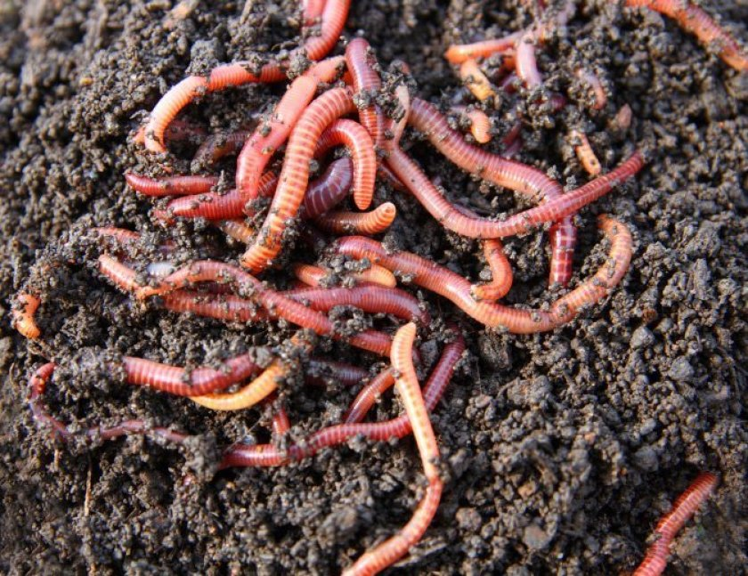
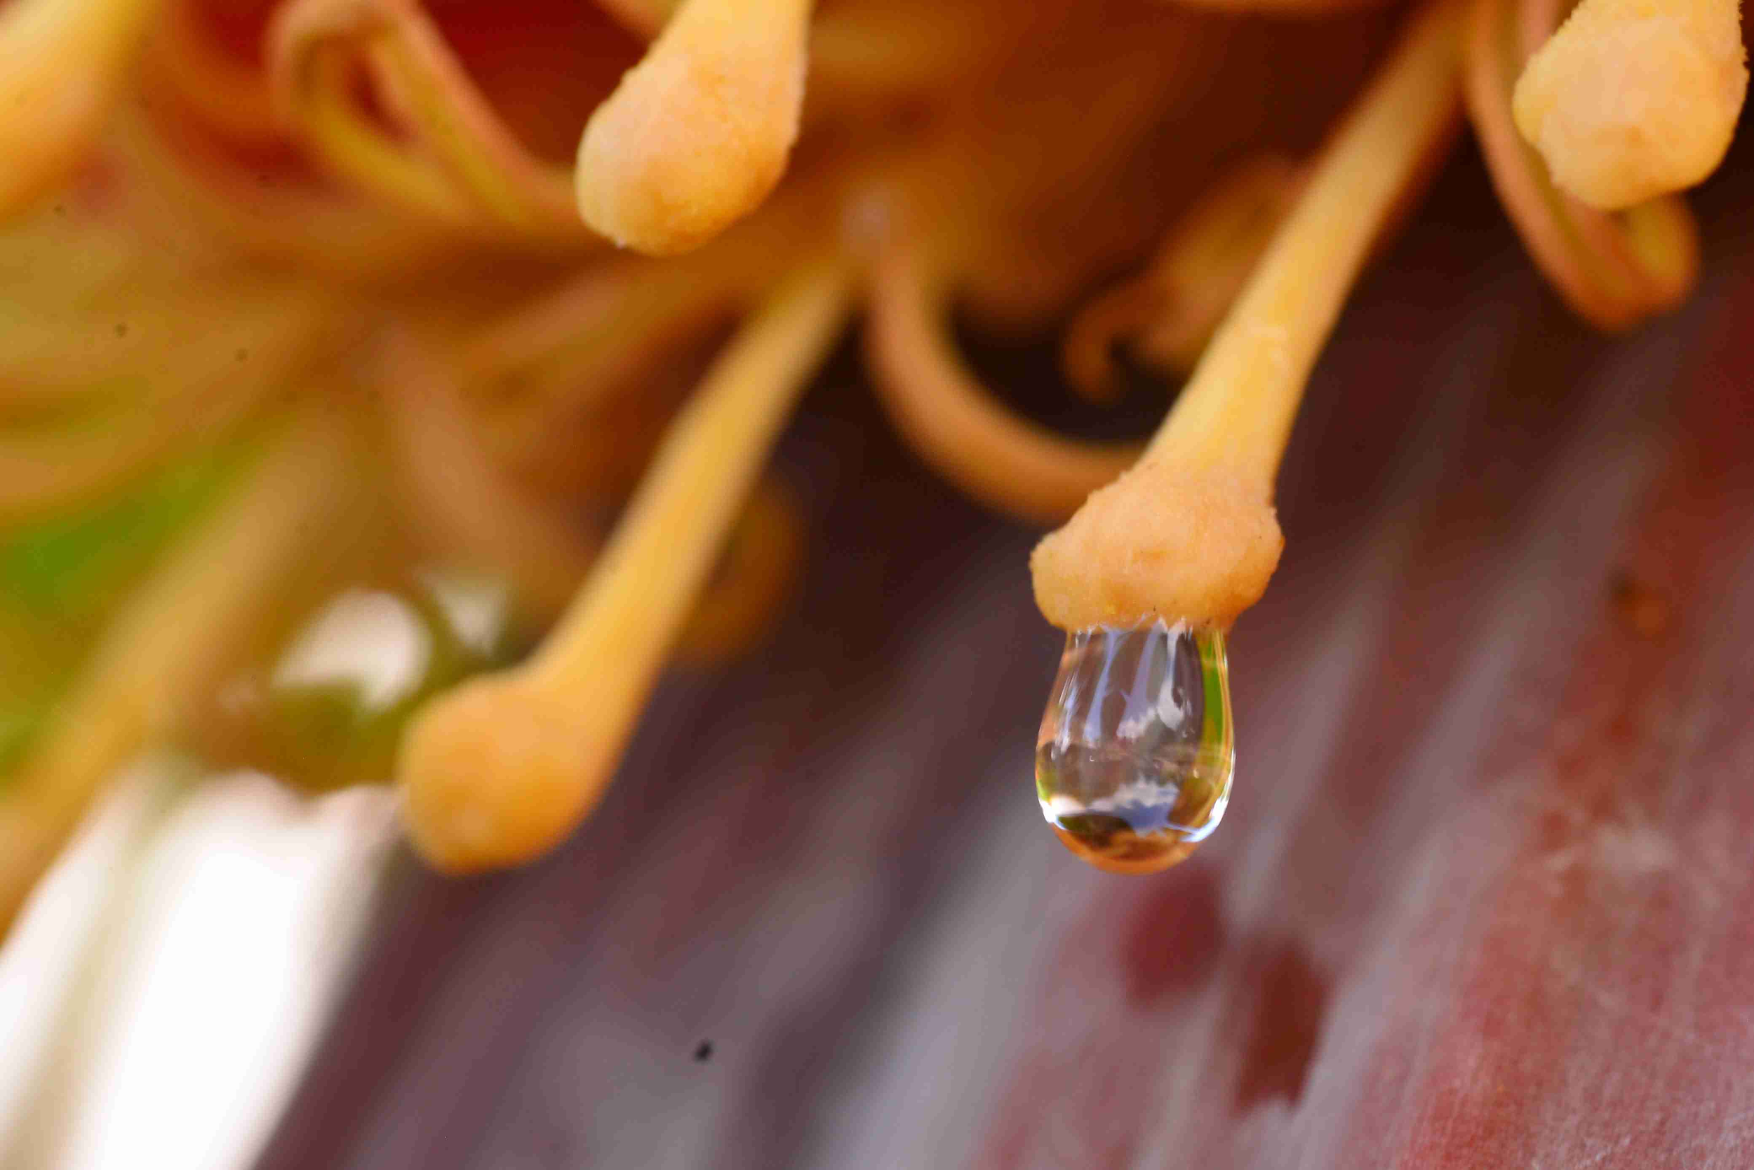
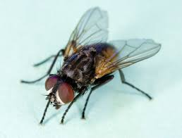
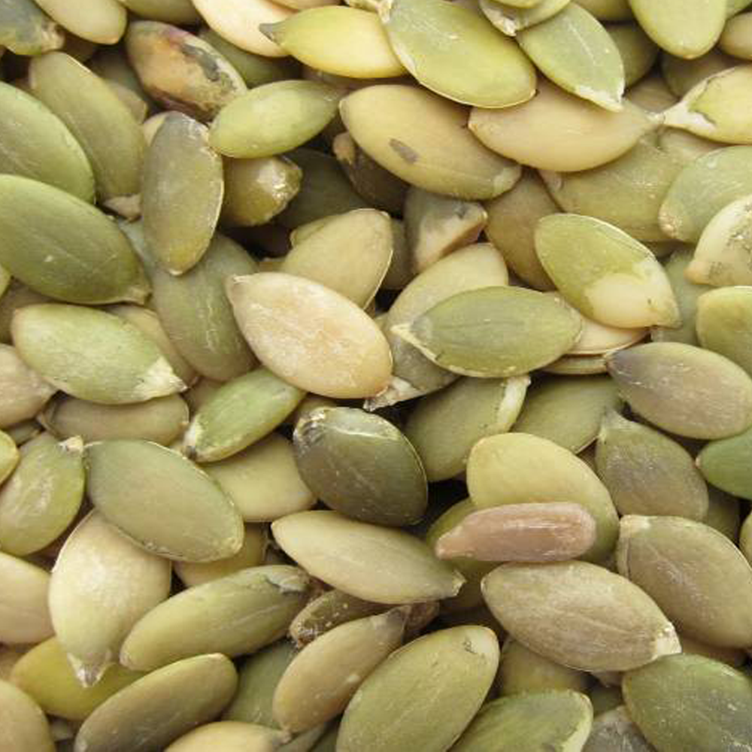
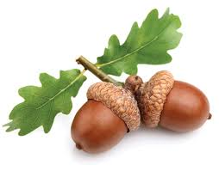
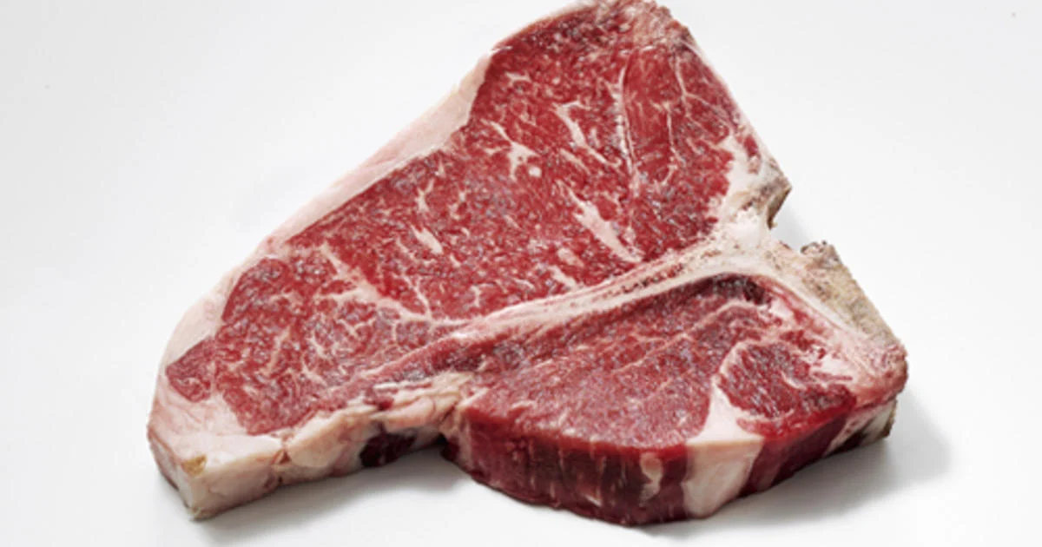
fish
worms
nectar
What kinds of food do you think birds eat?
insects
seeds and nuts
meat

Slide 7
Now that we have learned that different birds have different beaks so they can eat different kinds of food...we are going to play a matching game.
I am going to show you FOUR different bird beaks.
Take a look at each beak, one at a time. Write down what you notice about each beak and how you think it helps the bird get food, then compare your observations to ours! It’s okay if you write down different things!
We’ll start with an example.

Slide 8
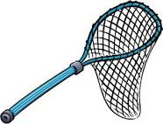
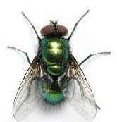
EXAMPLE
I notice that this bird’s beak is ____________ and ___________. It reminds me of ____________________.
I think this beak helps the bird (A)_______________________________ so I think it eats (B)_______________________.
I notice that this birds beak is small and open
very wide. It reminds me of a net. I think this beak helps the bird catch things so I think it eats insects!

Slide 9
BEAK #1
I notice that this bird’s beak is ____________ and ___________. It reminds me of ____________________.
I think this beak helps the bird (A)_______________________________ so I think it eats (B)___________________________.
I notice that this bird’s beak is big and pointy. It reminds me of a hook. I think this beak helps the bird grab and tear food so I think it eats meat!

Slide 10
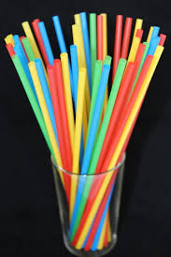
Bird beak #2
I notice that this bird’s beak is ____________ and ___________. It reminds me of ____________________.
I think this beak helps the bird (A)_____________________________ so I think it eats (B)___________________________.
I notice that this beak is very long and thin. It reminds me of a straw. I think this beak helps the bird sip and slurp so I think it eats nectar!

Slide 11
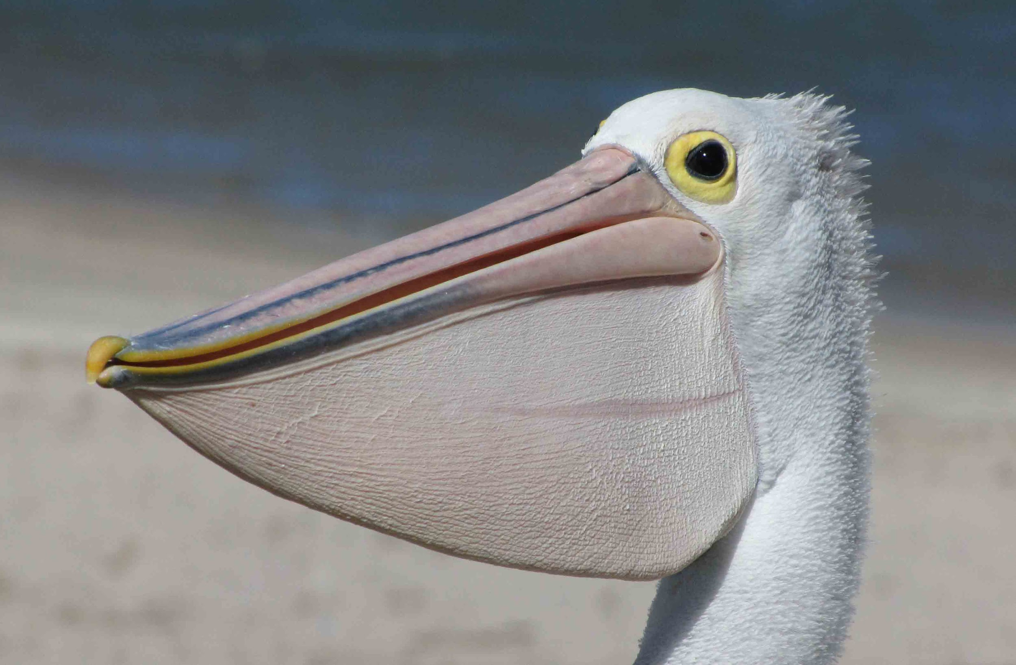
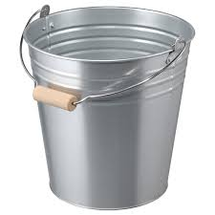
Bird beak #3
I notice that this bird’s beak is ____________ and ___________. It reminds me of ____________________.
I think this beak helps the bird (A)_________________________ so I think it eats (B)______________________.
This bird’s beak is big and long. It reminds me of a bucket. I think this beak helps the bird scoop up things so I think it eats fish!

Slide 12
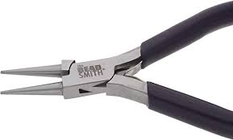
Bird beak #4
I notice that this bird’s beak is ____________ and ___________. It reminds me of ____________________.
I think this beak helps the bird (A)__________________________ so I think it eats (B)_____________________.
This bird’s beak is small and round. It reminds me of a pair of pliers. I think this beak helps the bird grab or crack things so I think it eats nuts and seeds!

Slide 13
Bird beak #1:
I am an EAGLE! I eat meat so I need a big sharp beak to tear and cut my food.
Bird Beak #2:
I am a HUMMINGBIRD! I drink nectar from flowers so I need a long straw-like beak for slurping!

Slide 14
Bird beak #3:
I am a PELICAN! I eat fish so I need a special pouch below my beak to scoop them up in the water!
Bird beak #4:
I am a SPARROW! I eat seeds and nuts so I need a strong beak to crack open their shells!

Slide 15
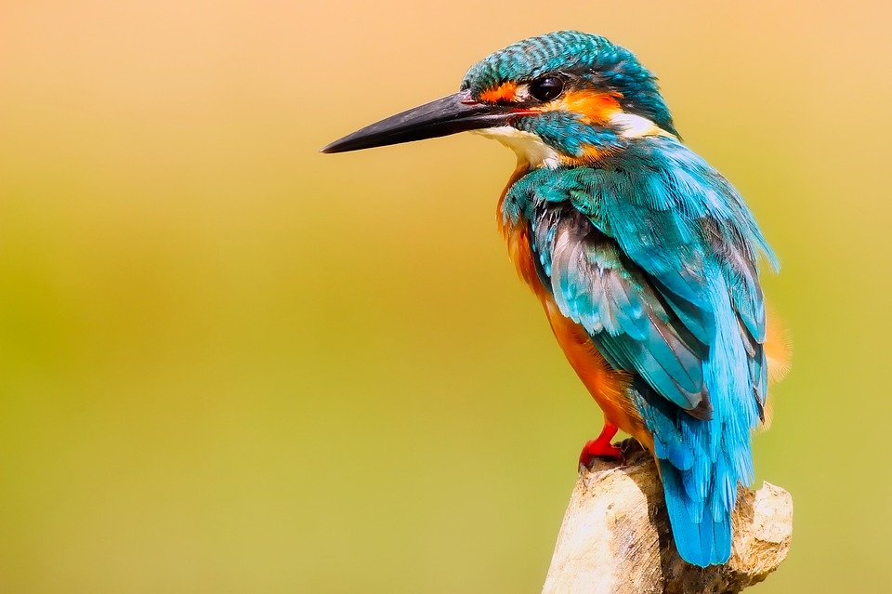
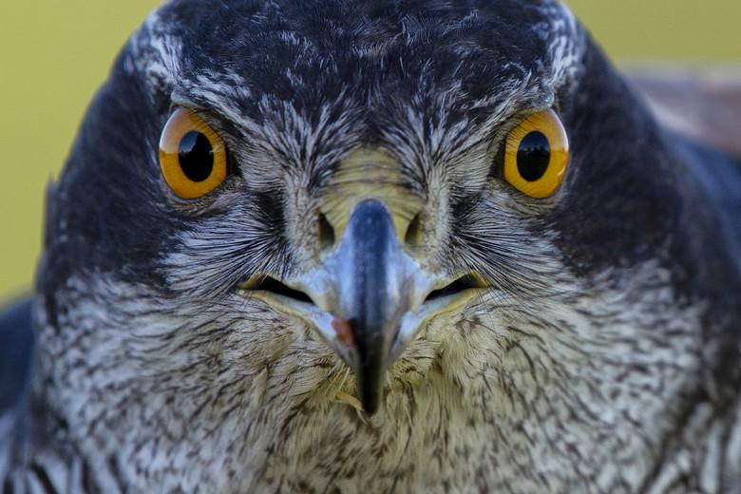
What have we learned?
Different beaks are adapted for eating different kinds of food!
You can tell a lot about a bird by its beak shape.
Try to think about other kinds of beaks, or look back at the beginning of the presentation and see if you can come up with ideas about what other kinds of birds eat!

