Slide 1
Animals in their habitats

Slide 2
Today we are going to be learning about wild animals that live in right here in Santa Cruz!
These animals all need some important things in order to survive.

Slide 3
SPACE
FOOD
We also need these important things to survive! Can you think of some things that help HUMANS survive?
WATER
SHELTER

Slide 4
SPACE
FOOD
Do you have a pet at home? What do PETS need to survive?
WATER
SHELTER

Slide 5
SPACE
FOOD
What do WILD ANIMALS (animals that live on their own in nature) need to survive?
WATER
SHELTER

Slide 6
All living things need FOOD, WATER, SHELTER, and SPACE to survive.
Can you think of a science word for a place that an animal might live that has all of these things?
That word is HABITAT!
Can you think of any types of habitats?
ocean, forest, desert, underground

Slide 7
Tree tops
forest
This is an example of a place with different habitats.
What kinds of habitats can you see?
Where do you think animals could find food, water, shelter, and space in this picture?
meadow

Slide 8
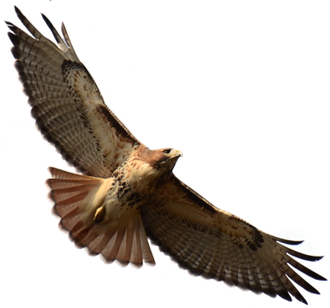
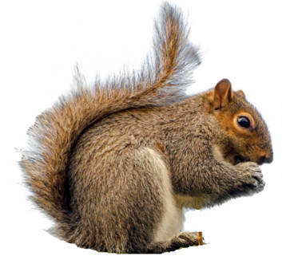
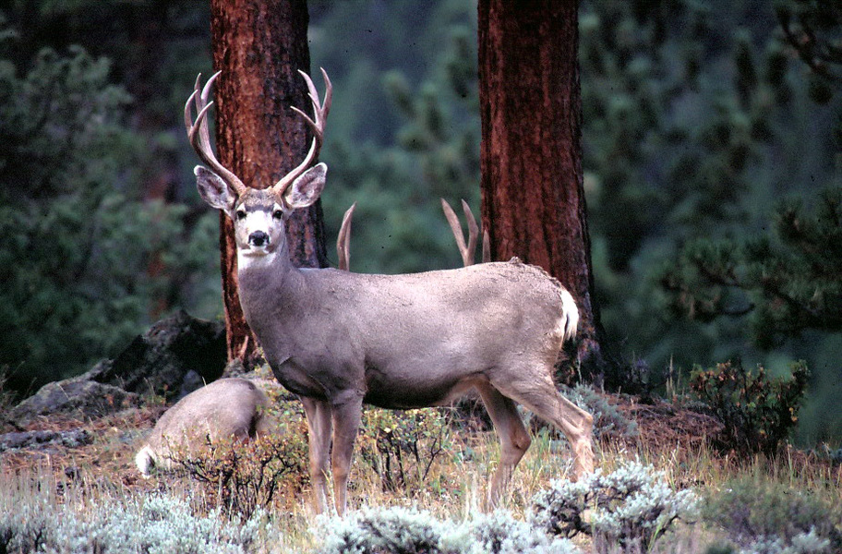
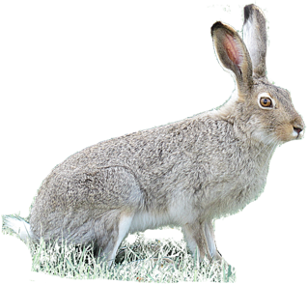
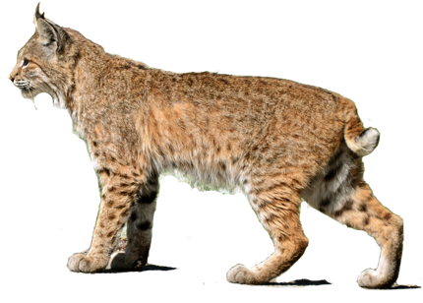
Hawk
Squirrel
There are lots of different animals that live in these habitats, but today we are going to focus on just five of them. Have you ever seen any of these animals before?
Deer
Jackrabbit
Bobcat

Slide 9
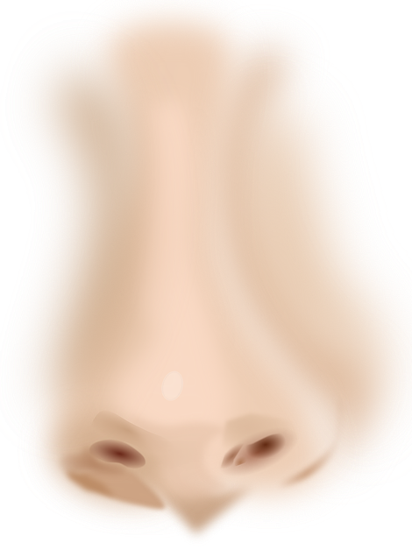
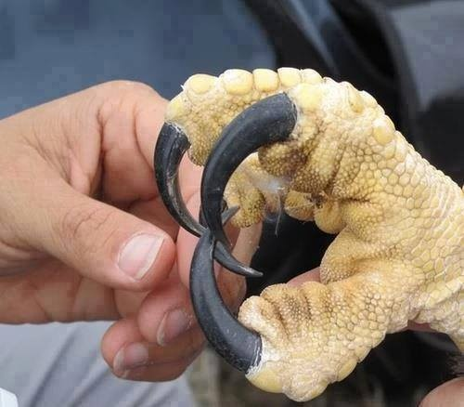
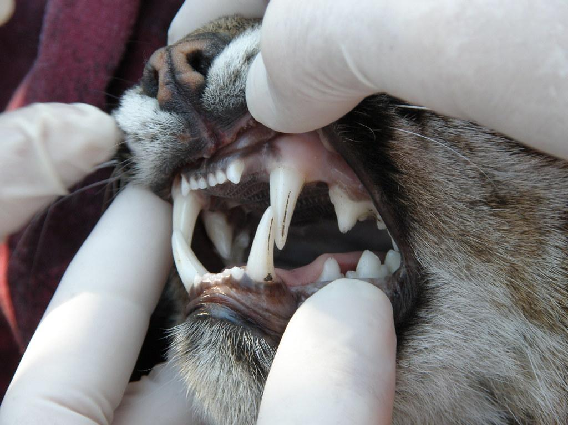
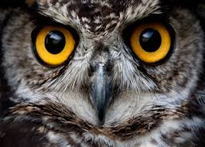
Sense of smell
All animals have different ways of surviving, finding or catching their food, escaping predators, and making shelters. Let’s think about food, something all animals need to survive.
How do some animals catch or find food?
Claws or fangs
Good eyesight

Slide 10
Claws, fangs, good eyesight, and a sense of smell are all Adaptations, or things that animals have that help them survive.
What are some other adaptations that animals have? Try to come up with a list of five!
Next, you are going to explore some different animals and their adaptations!

Slide 11
Read some clues about each of these animals and what they need to survive in their habitat.
See if you can guess which animal is being described!
Click the next slide to reveal each answer.

Slide 12
Animal #1!
WHO AM I?
Clues:
I am big with skinny legs
I live in forests and meadows
I eat plants - leaves, berries, grass, and acorns are some of my favorite foods, and I have flat teeth for grinding them up!
I have big eyes to see predators coming, and big ears to hear them.
Males have antlers on their heads
I AM A DEER!

Slide 13
Animal #2!
WHO AM I?
I have big wings and feathers to fly
I have big sharp talons (feet) to catch my food
Some animals I eat include rabbits, mice, snakes...but I’m not picky!
I need tall trees to make safe nests for my babies.
When I stretch out my wings, they are about 4 feet wide!
I AM A HAWK!

Slide 14
Animal #3!
WHO AM I?
I have big ears to hear predators (animals that might try to eat me!)
I have big legs to hop and can run fast to escape.
I eat plants.
You can find me in big open spaces, like meadows or fields.
I can run up to 40 miles per hour!
I AM A JACKRABBIT!

Slide 15
Animal #4!
I have powerful legs for running fast.
I have long claws to catch prey.
I have spots to help me blend in.
I eat rabbits, rodents, and birds.
I sleep and keep my babies in dens, usually in logs or caves.
You can find me at night in the forest.
WHO AM I?
I AM A BOBCAT!

Slide 16
Animal #5!
WHO AM I?
You might see me often in parks or around your neighborhood on telephone poles!
I eat seeds, insects, nuts, and fruit...but I might steal your food, too!
I have cheek pouches to store my food.
I have a big tail to help me balance on branches.
I can climb trees to escape and feel safe, where you can find me with my friends.
I AM A SQUIRREL!

Slide 17
Good job! Now, point to each place in this picture where you think that you might find those animals. Try to think about some other animals you might find out in the wild. What adaptations do they have that help them survive?

